Slide 1
Project 2: Motion Detection via Communication Signals
Group member: 张怡程 马文骁 陈嘉祺 高进

Slide 2
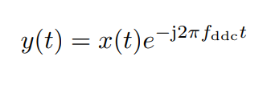
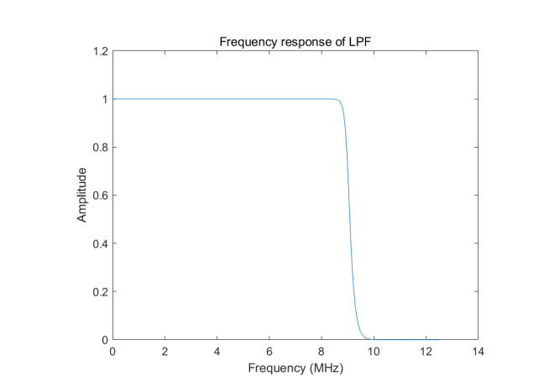
Intro. 1: Time Domain Processing of Signal
Digital Downconversion(DDC):
Low-Pass Filter(LPF)

Slide 3
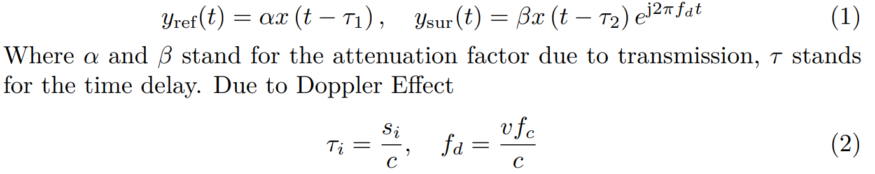
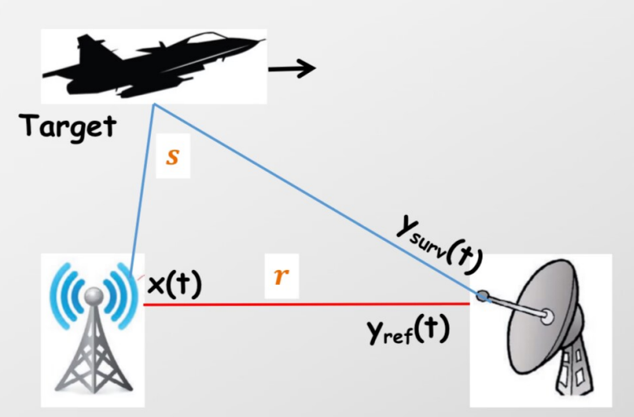
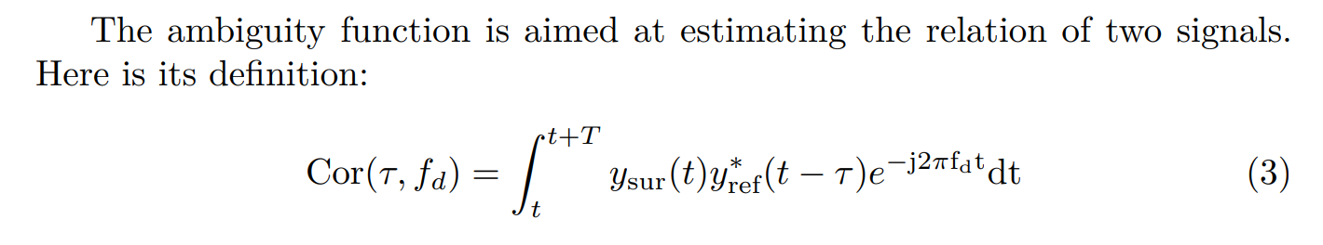
Intro. 2: Principles of Motion Detection
Cross-Correlation (Ambiguity Function)

Slide 4
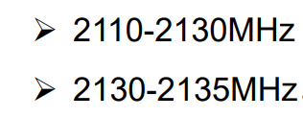

Task 1
Raw Data
DDC
LPF
Data status
Convert the signal 2110MHz-2135MHz to the frequency centered on 0Hz
2110~2130MHz reserved
2130-2135MHz filtered out
Principle
Design a Butterworth filter with bandwidth = 9e6

Slide 5
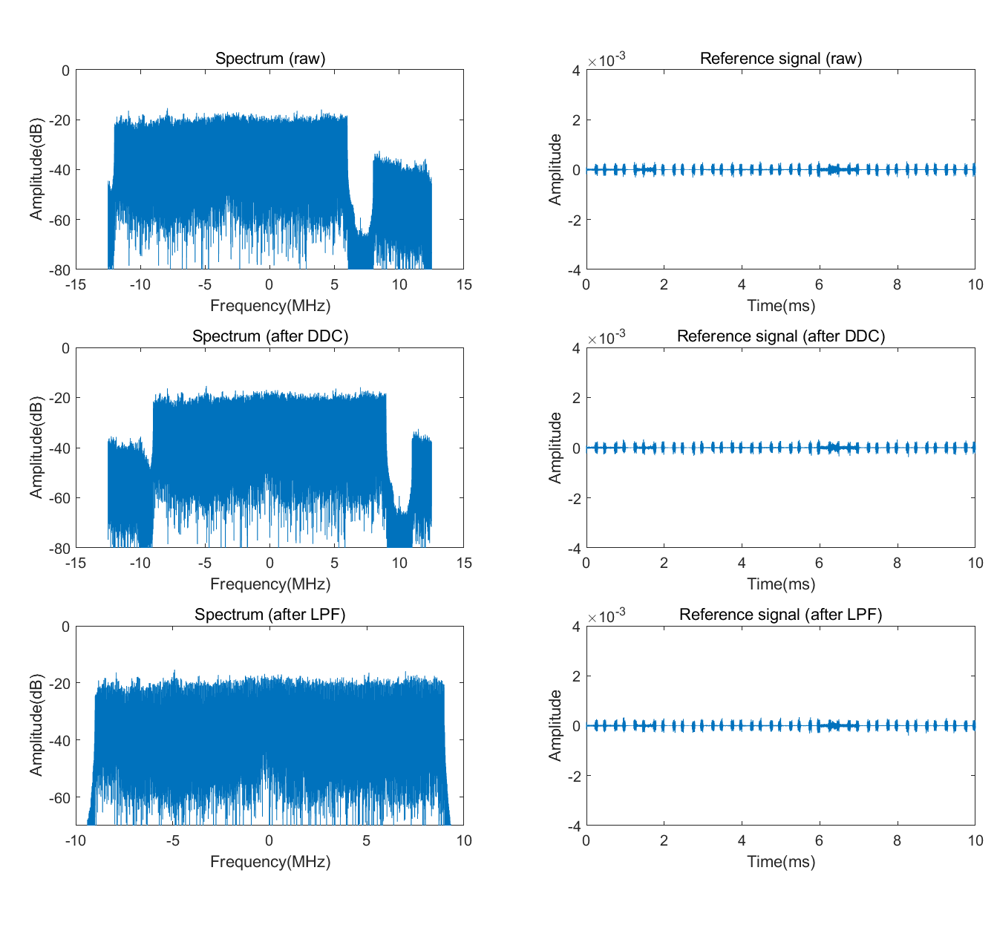
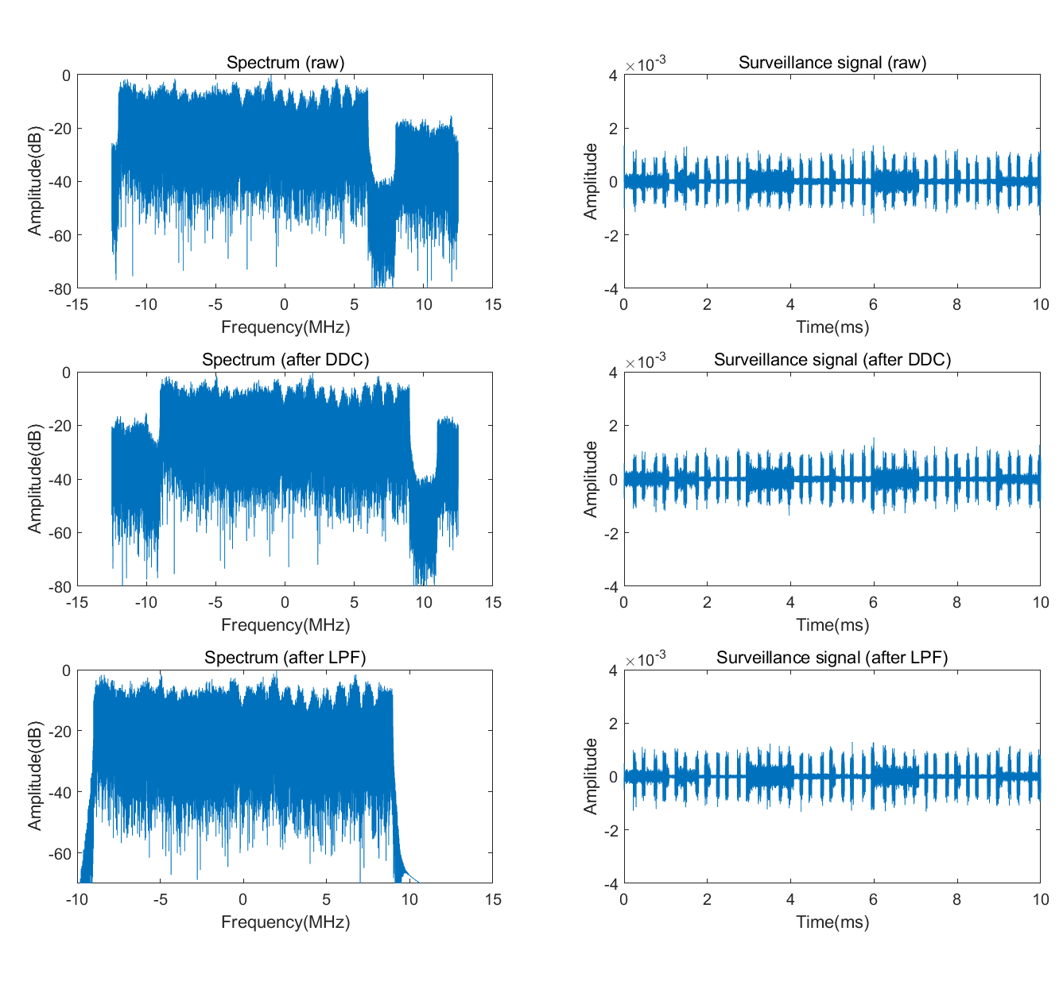
Task 1
data_1.mat (0.01s) as an example
Reference Signal
Surveillance Signal
Raw Data
After DDC
After LPF

Slide 6
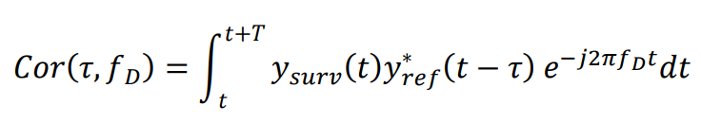
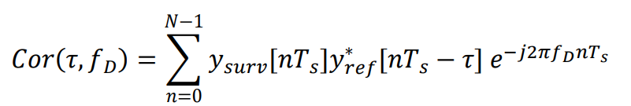

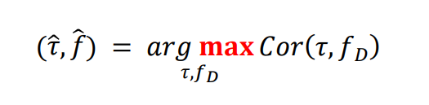
Task 2
τ can only be a multiple of Ts
Nτ = 0:1:6 ←→ Range(m) = 0:12:72
fD could be both negative and positive
fD(Hz) = -40:2:40

Slide 7
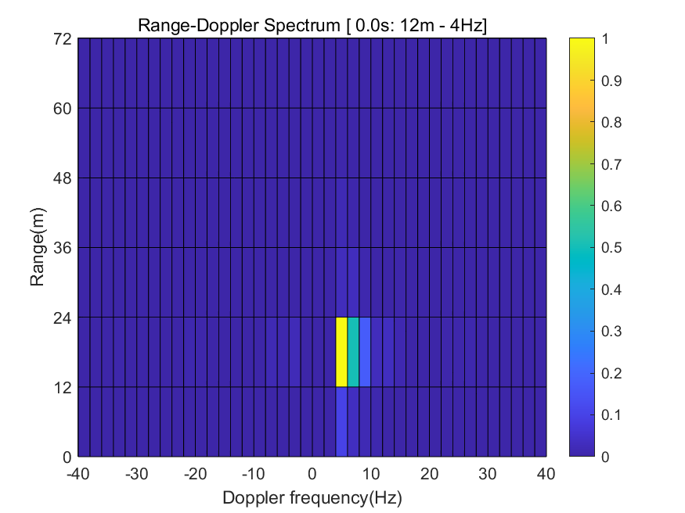
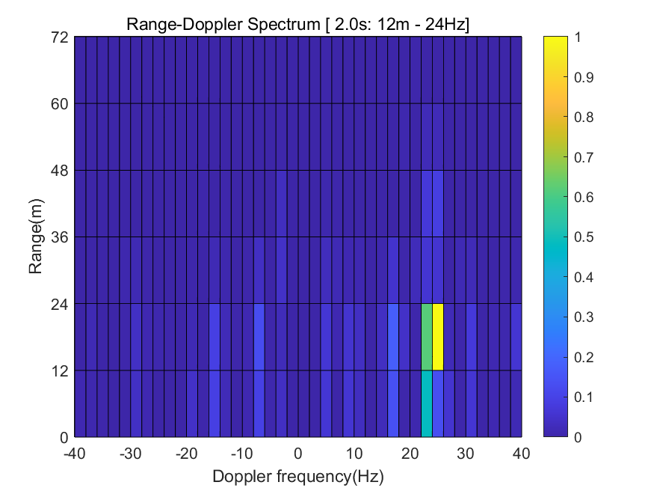
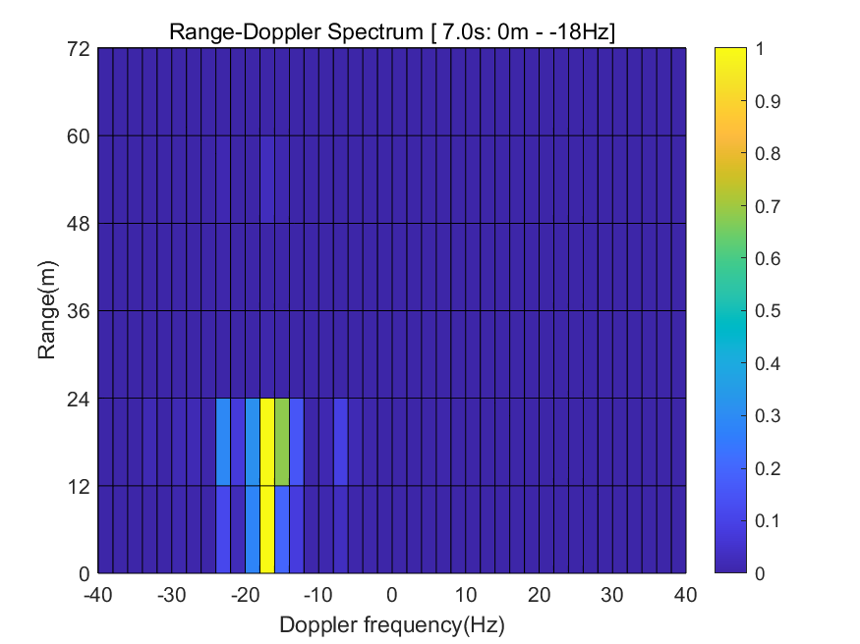
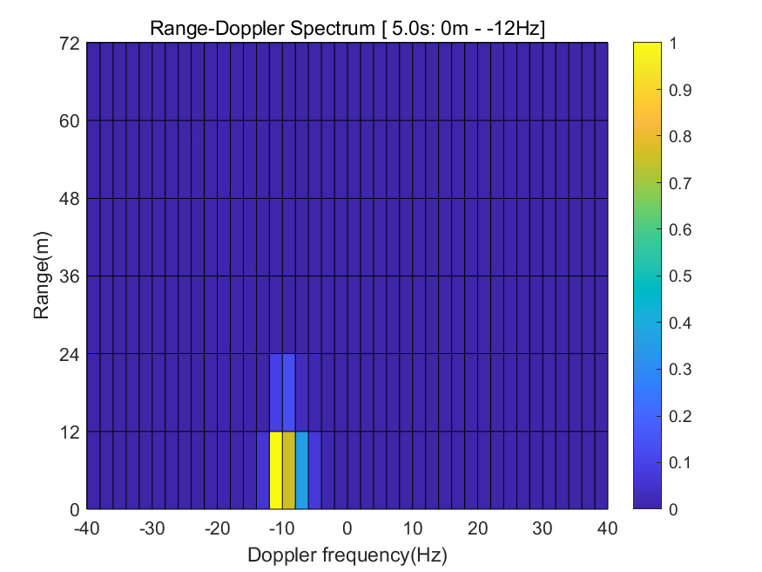
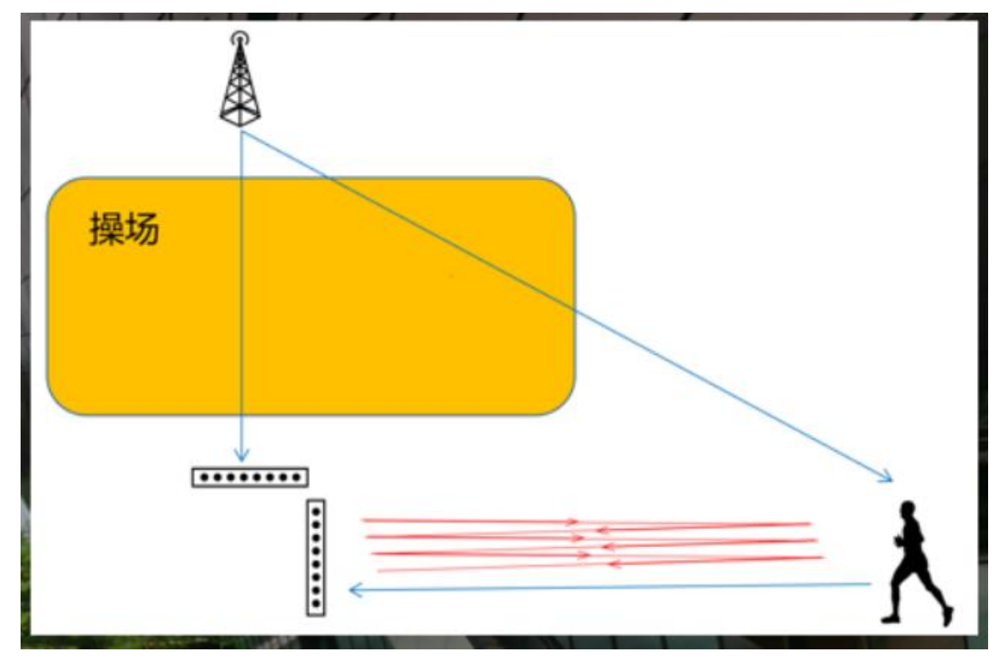
Task 2
Closer
Range ≈ 12m
Closer
Range ≈ 12m
Δf = f' - f
Closer: Δf > 0
Farther: Δf < 0
Range = s-r
Farther
Range ≈ 0m
Farther
Range ≈ 0m
r
s

Slide 8
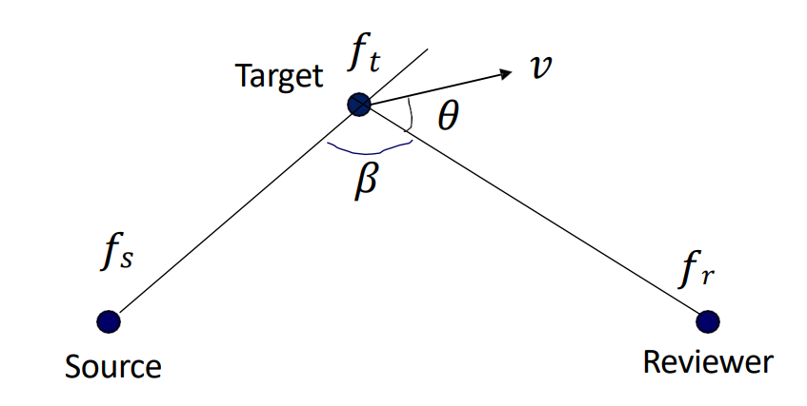
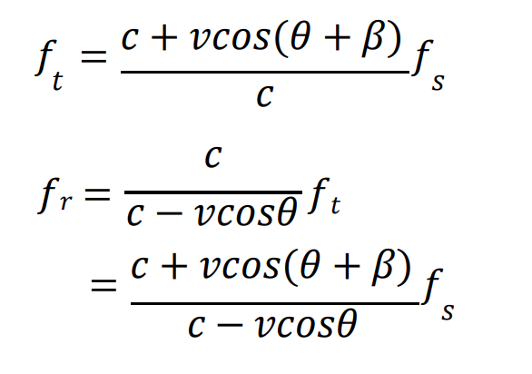
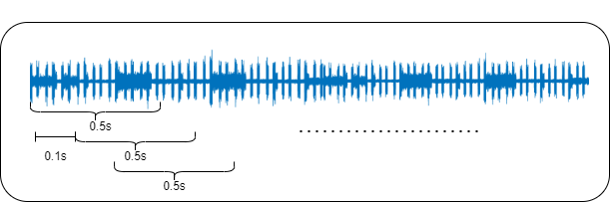
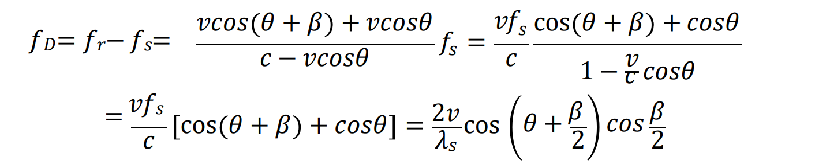
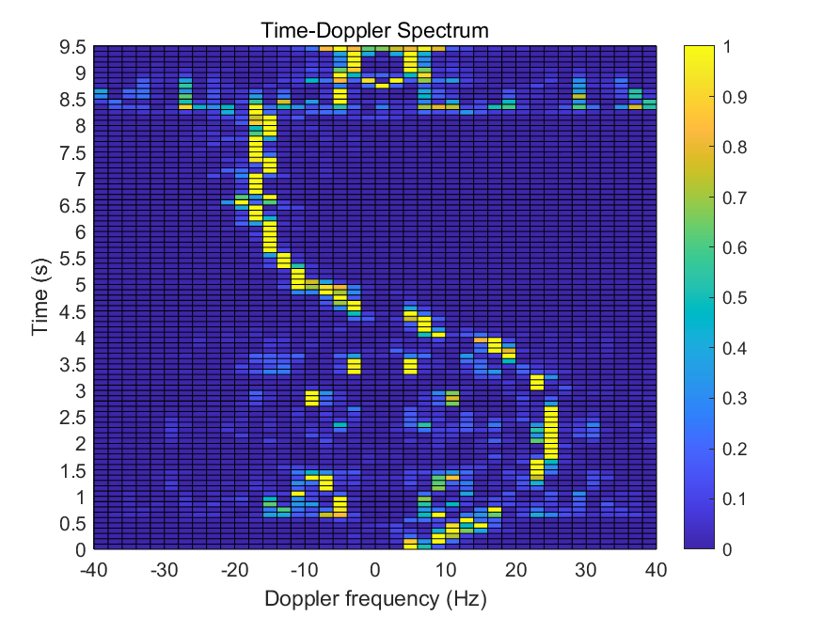
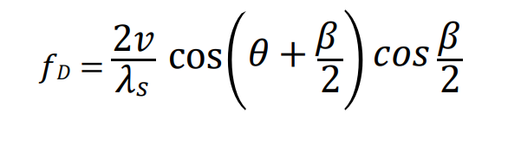
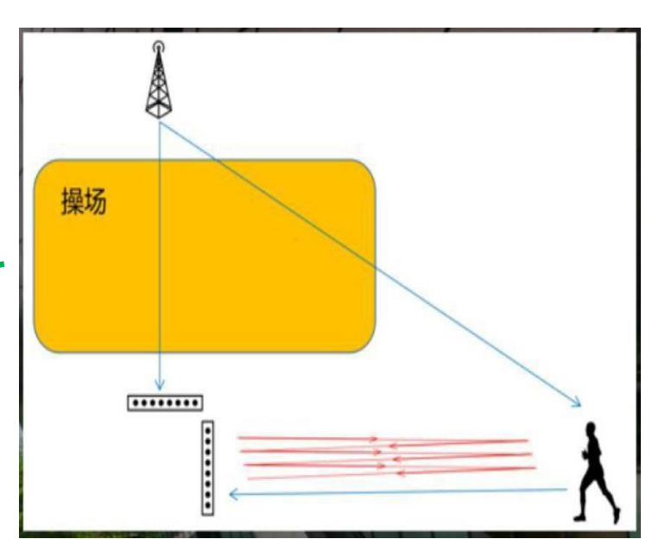
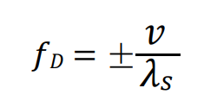
Task 3
The relationship between velocity and Doppler frequency
Method of signal segmentation (EX. 0.1s)
Source
β ≈ 90°
θ ≈ 0° or 180°
β
Target
Reviewer

Slide 9
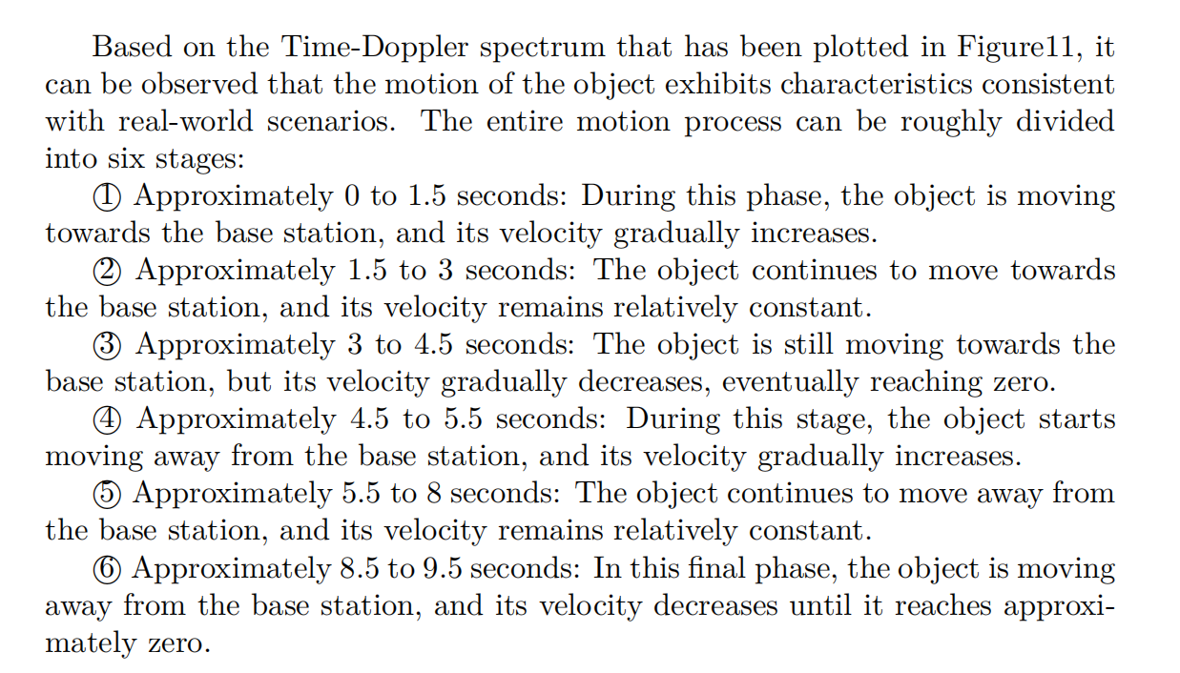
Task 3

Slide 10
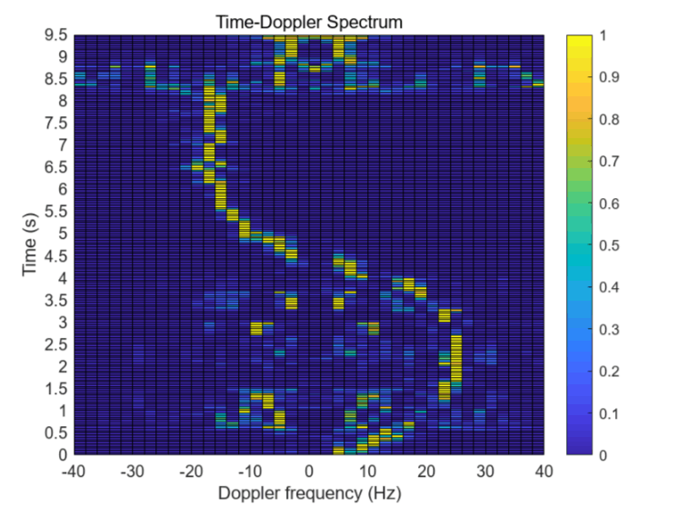
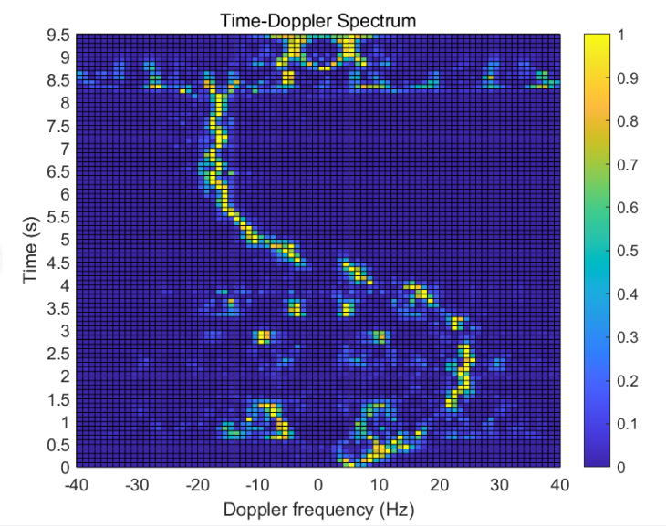
Ext. 1: Further Refinement of the Time-Doppler Spectrum on the Scale.
Time precision: 0.1s
Frequency precision: 2Hz
Time precision: 0.05s
Frequency precision: 2Hz
Time precision: 0.1s
Frequency precision: 1Hz

Slide 11
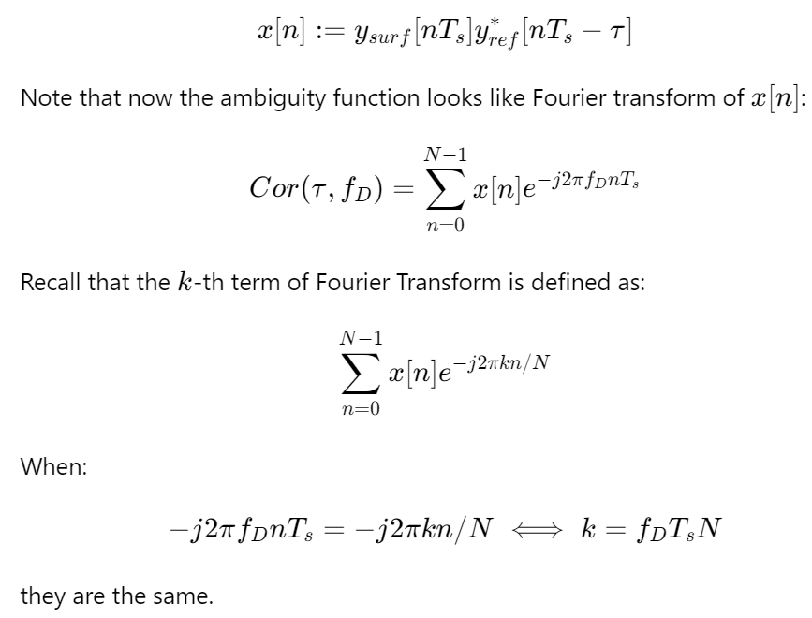
Ext. 2: Optimization of Algorithm

Slide 12
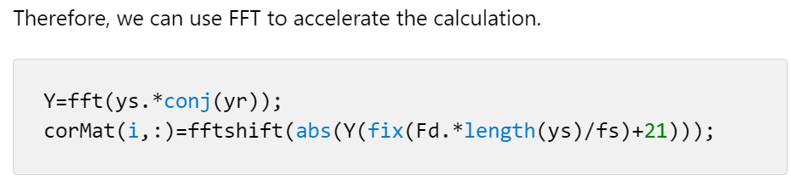
Ext. 2: Optimization of Algorithm

Slide 13
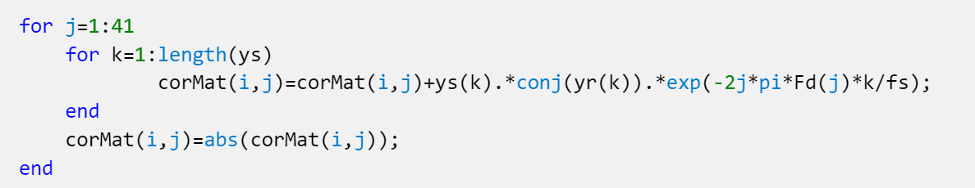
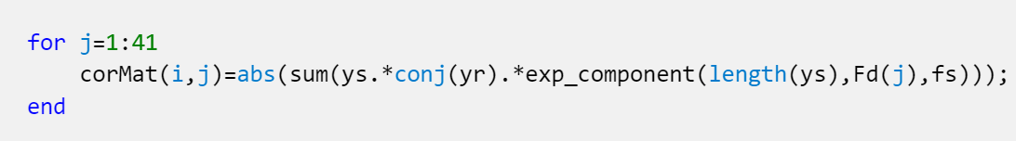

Ext. 2: Optimization of Algorithm
`for` Loop
Matrix Operations (`.*`, sum())
FFT

Slide 14
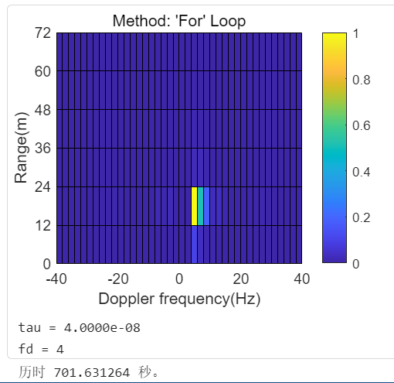
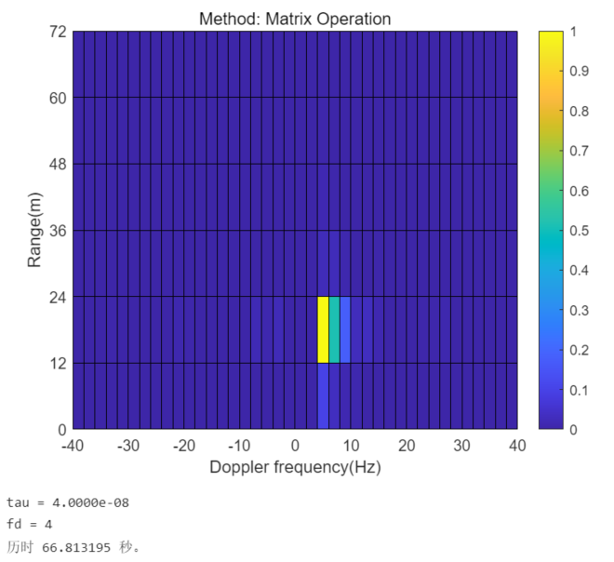
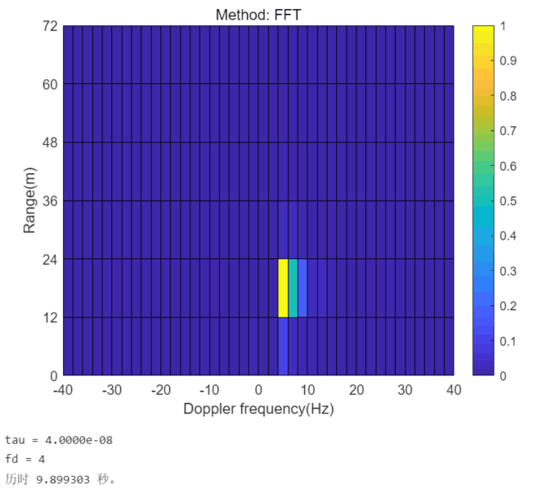
Ext. 2: Optimization of Algorithm
Method | Time
`for` Loop | 701.6s
Matrix Operation | 66.8s
FFT | 9.90s

Slide 15
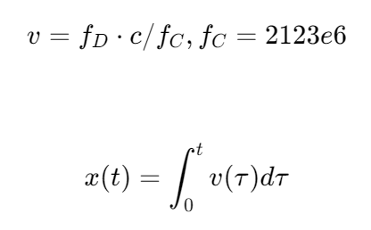
Ext. 3: Recover the Object’s Movement

Slide 16
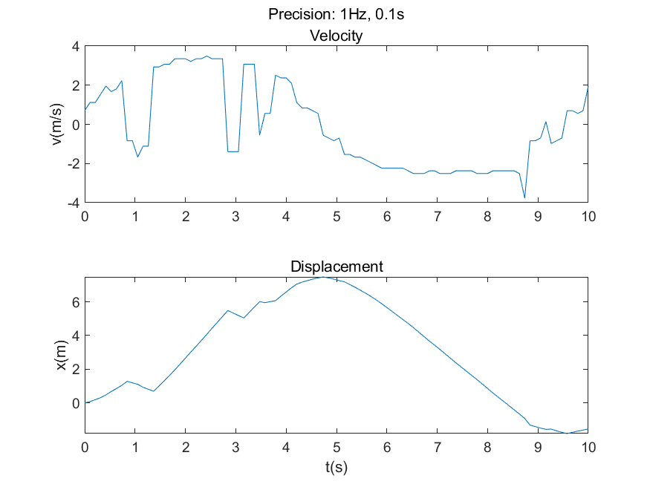
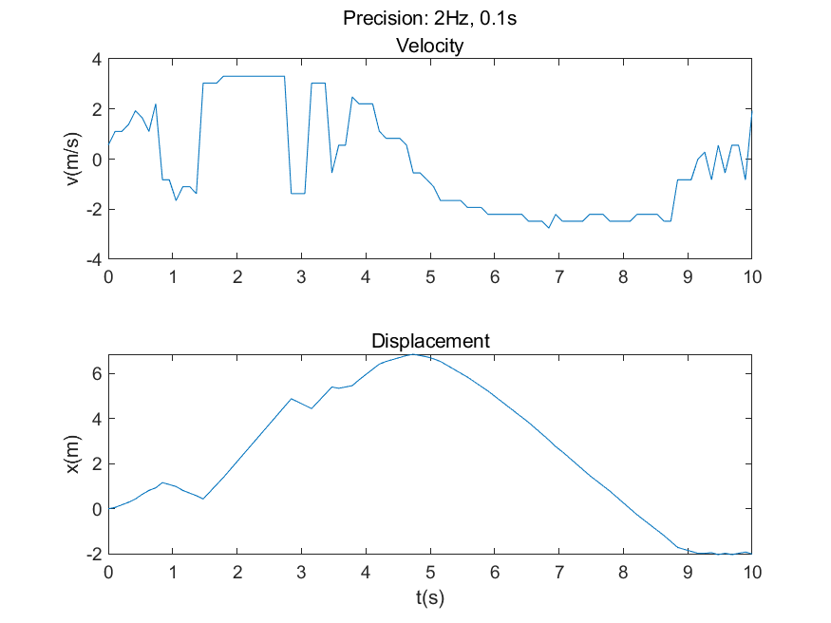
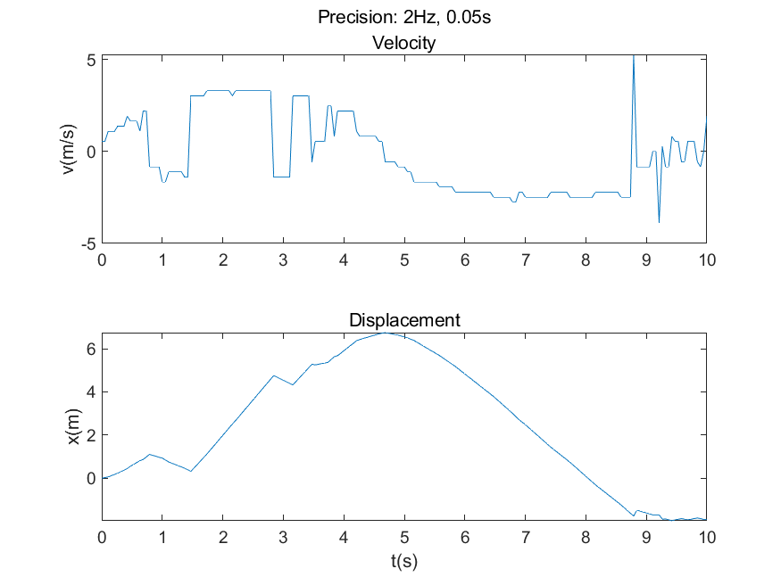
Ext. 3: Recover the Object’s Movement

Slide 17
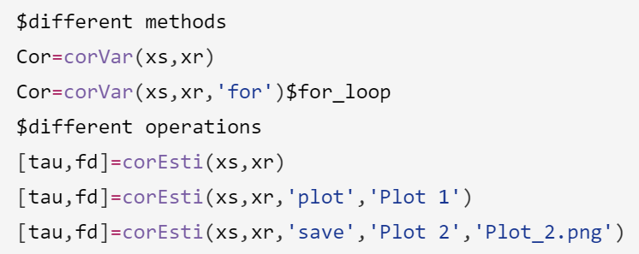
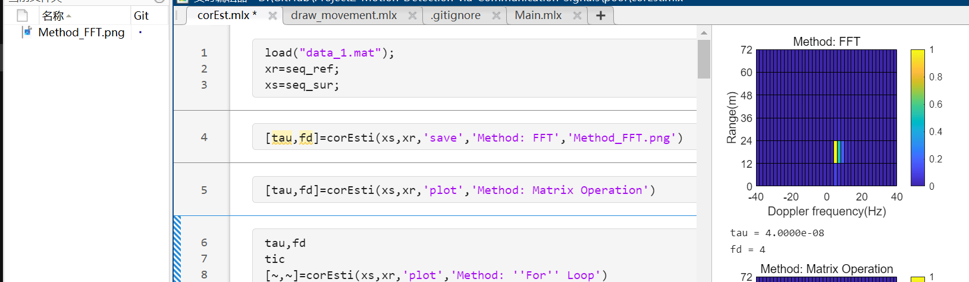
Ext. 4: Coding Habits—Encapsulation, varargin

Slide 18
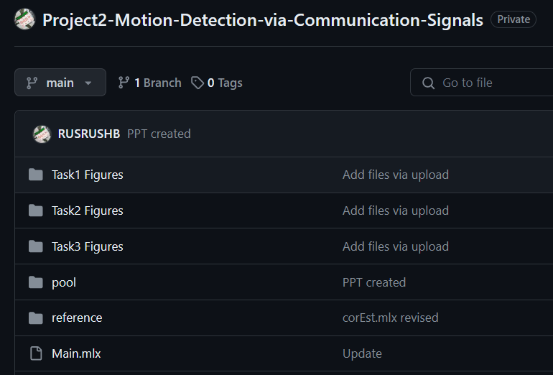
Ext 4: Coding Habits——Git

Slide 19
Bonus
Extension 1: Further Refinement of the Time-Doppler Spectrum
Extension 2: Optimization of Algorithm
Extension 3: v-t graph, x-t graph
Extension 4: Encapsulation, varargin, Git

Slide 20
Thank you for your listening

